Slide 1
VectorBiTE Temperature Variation Working Group
Recap for 2019 Meeting in Trento Italy
Joey Bernhardt, Zach Gajewski, Cynthia Lord, Marta Shocket, Annaliese Wieler

Slide 2
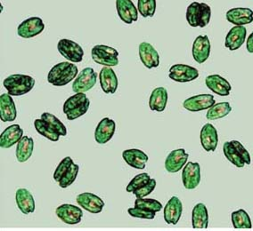
Dataset – 15 studies, ectotherms
Does rate summation approach adequately account for effects of variation in temperature
(vs. mean temperature)?

Slide 3
Progress!!!
Picked one dataset, converted analysis to Bayes (thank you Leah!), went from soup to nuts
Developed statistical approach and detailed hypotheses
Ongoing data digitization
Outlined 1st paper (intro, methods, figures, boxes, etc.)
Defined scope, goals, audience for 1st paper vs. 2nd paper
Trait-level analysis, all available data (regardless of organism), focus on mathematical principles, general ecology audience
Trait-level -> predicted transmission, use 1-2 examples from vector species, focus on disease transmission application, contrast with degree day approach, entomological/epidemiological audience

Slide 4
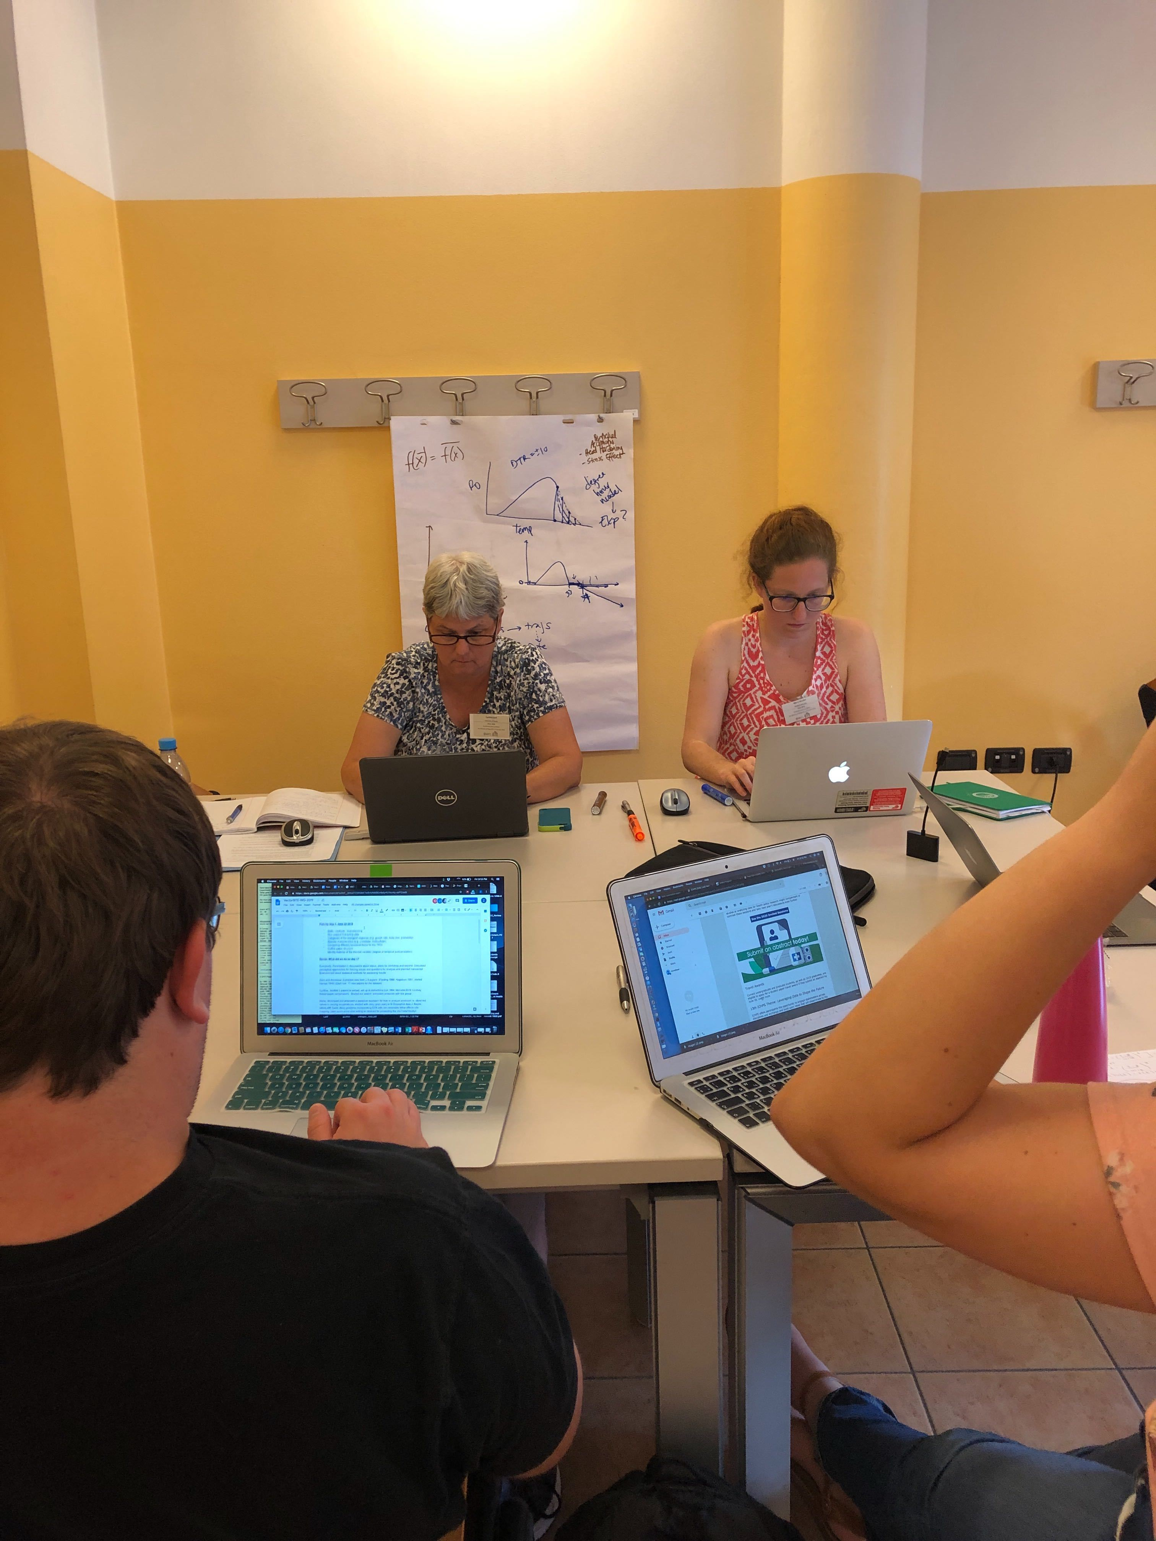
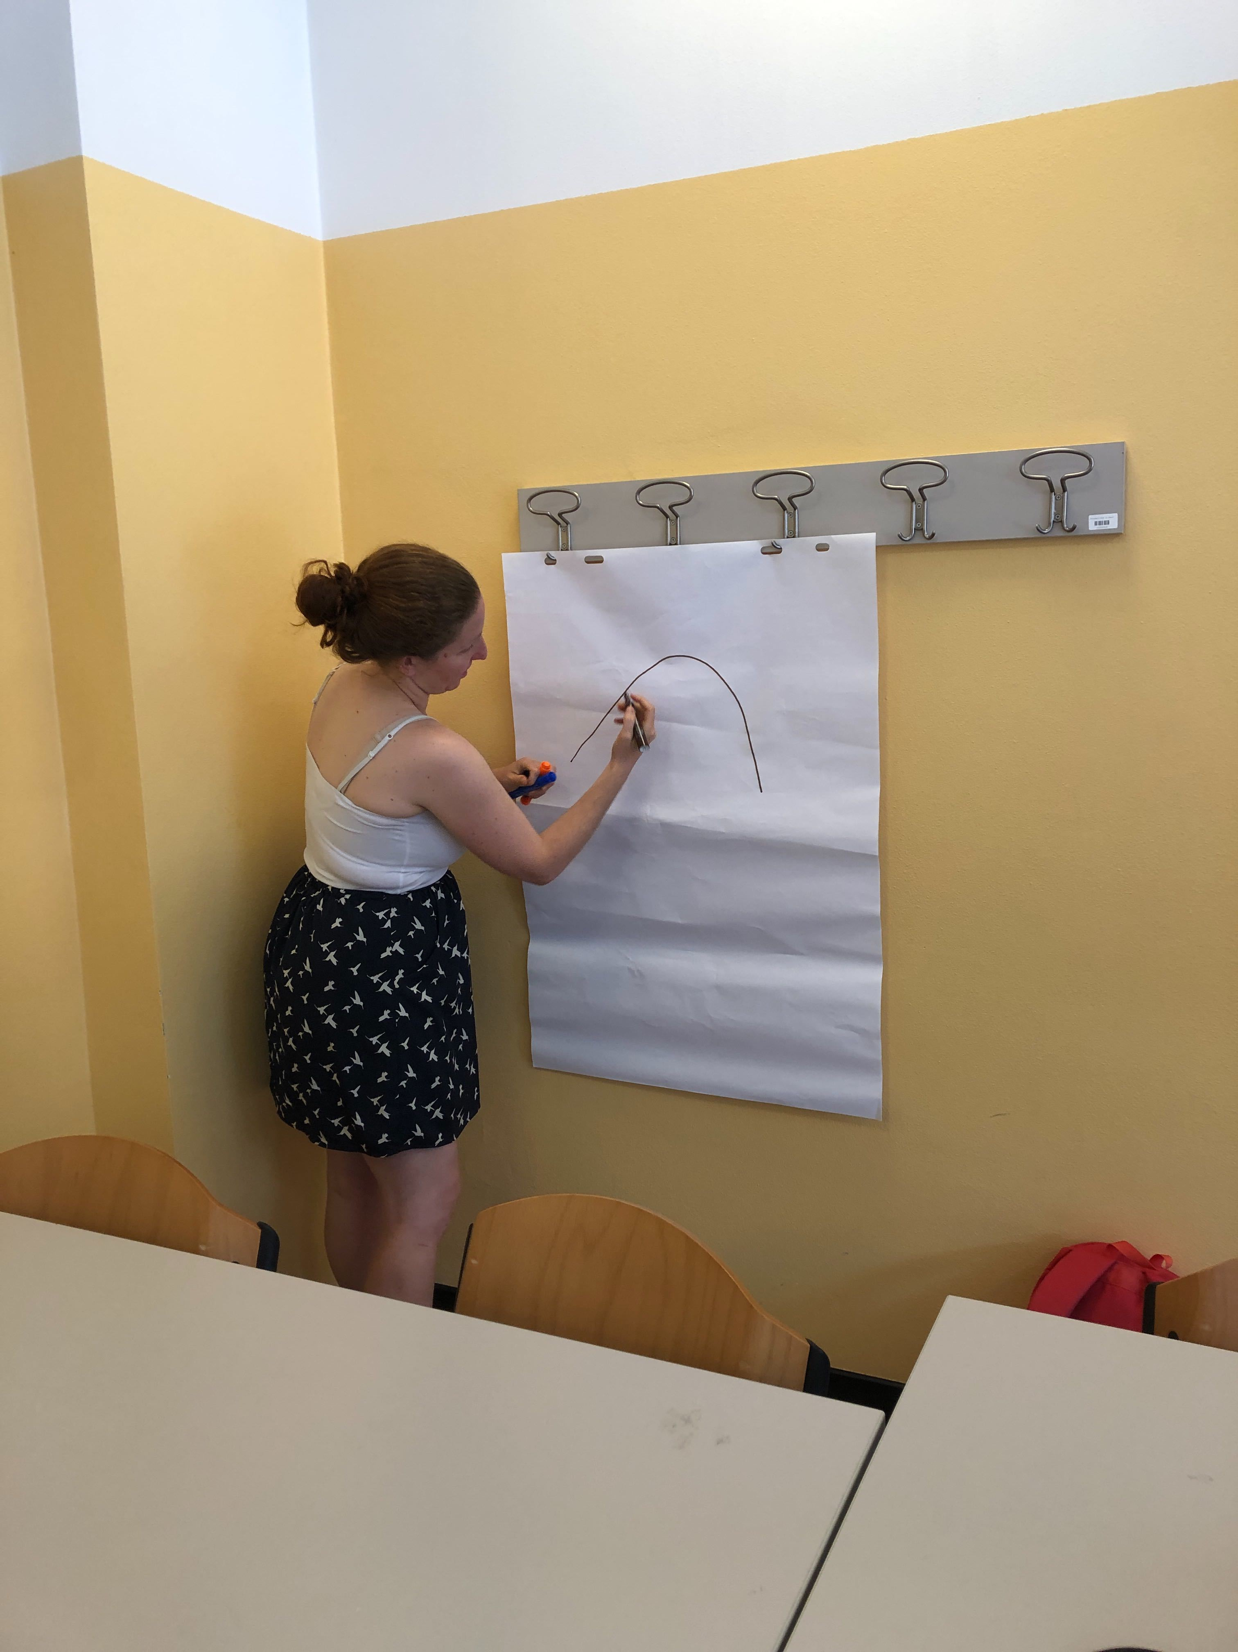
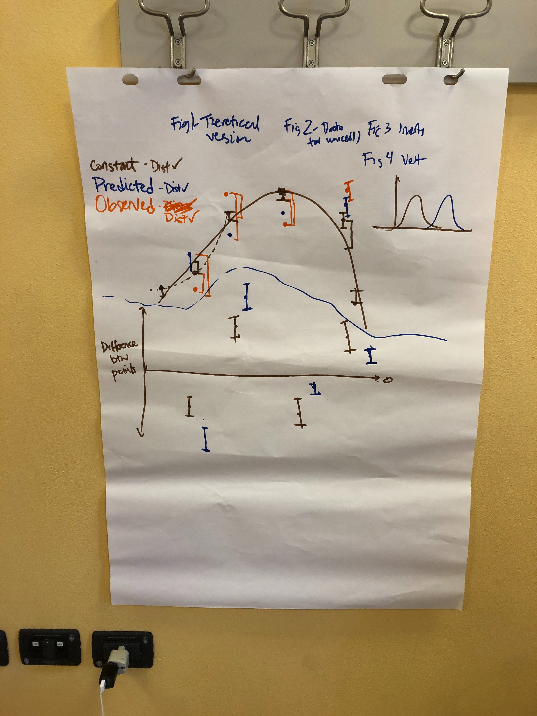

Slide 5
